Slide 1
Transfer Shared-Dictionary Learning for Domain adaptation
Jinfeng Li
2019/8/24

Slide 2
Introduction:
1. We aim to minimize the distribution divergence between source and target data from two perspectives, i.e., statistical and geometric views.
2. We obtain a cross-shared dictionary (a group of basis) and the new representations for two domains.
3. The tasks can be achieved on the new representations, which are robust for different distributions.

Slide 3
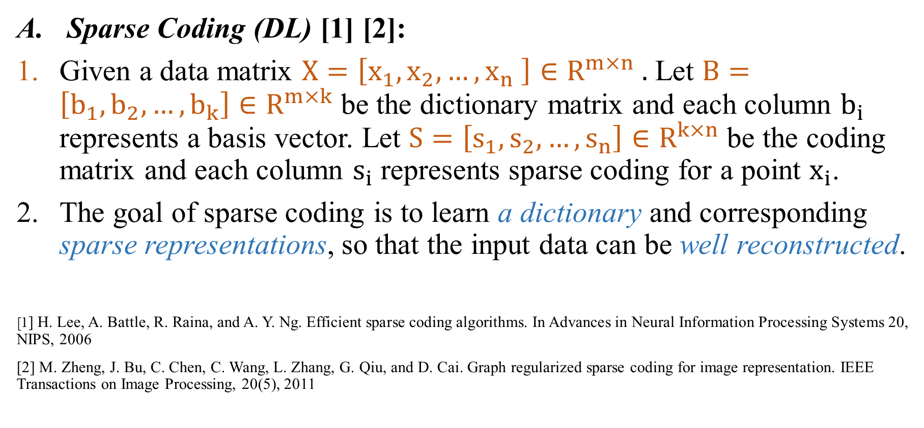
Related works
Sparse Coding (DL) [1] [2]:
Given a data matrix $X=\left[x_{1},x_{2},…,x_{n} \right]∈R^{m×n} .$ Let $B=\left[b_{1},b_{2}, …,b_{k}\right]∈R^{m×k}$ be the dictionary matrix and each column $b_{i}$ represents a basis vector. Let $S=\left[s_{1},s_{2}, …,s_{n}\right]∈R^{k×n}$ be the coding matrix and each column $s_{i}$ represents sparse coding for a point $x_{i}$.
The goal of sparse coding is to learn a dictionary and corresponding sparse representations, so that the input data can be well reconstructed.
[1] H. Lee, A. Battle, R. Raina, and A. Y. Ng. Efficient sparse coding algorithms. In Advances in Neural Information Processing Systems 20, NIPS, 2006
[2] M. Zheng, J. Bu, C. Chen, C. Wang, L. Zhang, G. Qiu, and D. Cai. Graph regularized sparse coding for image representation. IEEE Transactions on Image Processing, 20(5), 2011

Slide 4
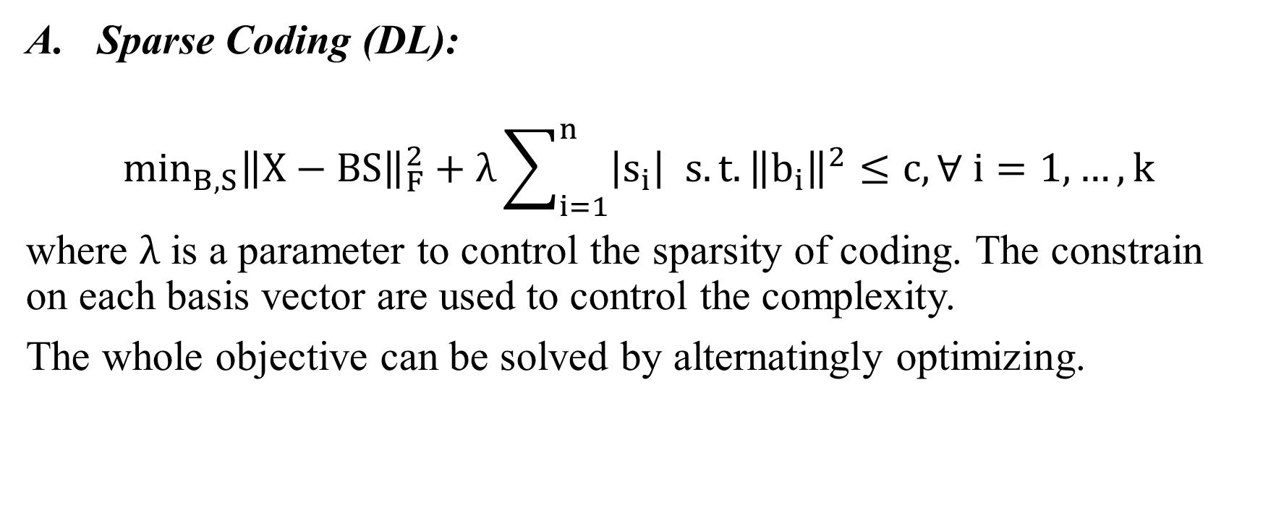
Related works
Sparse Coding (DL):
$$\min_{B,S}{\left\|X−BS\right\|}_{F}^{2}+λ\sum_{i=1}^{n}{\left|s_{i}\right| s.t. {\left\|b_{i}\right\|}^{2}}≤c, ∀ i=1,…, k$$
where $λ$ is a parameter to control the sparsity of coding. The constrain on each basis vector are used to control the complexity.
The whole objective can be solved by alternatingly optimizing.

Slide 5
Question:
When training data and testing data are sampled from different distributions, they may be encoded with different representations with different dictionaries.
In this case, the dictionary achieved from training data can not be directly applied to testing data.
Method:
Discover a shared dictionary to encode source and target data, the distribution divergence can be reduced under the new sparse representations.

Slide 6
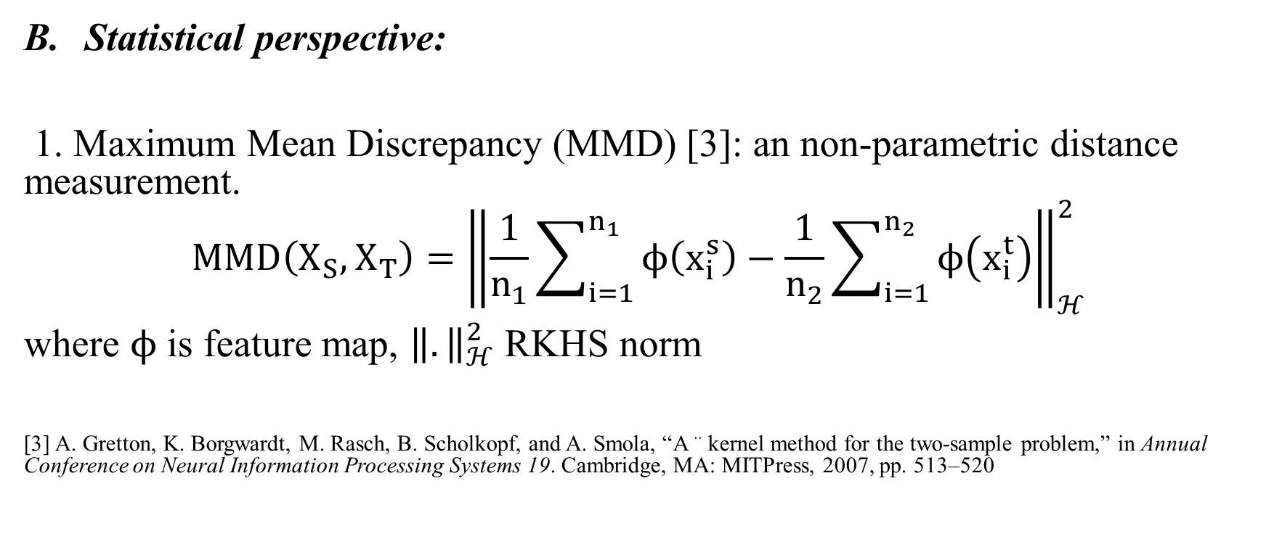
Related works
Statistical perspective:
1. Maximum Mean Discrepancy (MMD) [3]: an non-parametric distance measurement.
$$MMD\left(X_{S},X_{T}\right)={\left\|\frac{1}{n_{1}}\sum_{i=1}^{n_{1}}{ϕ\left(x_{i}^{s}\right)−\frac{1}{n_{2}}\sum_{i=1}^{n_{2}}{ϕ\left(x_{i}^{t}\right)}}\right\|}_{ℋ}^{2}$$
where $ϕ$ is feature map, ${\left\|.\right\|}_{ℋ}^{2}$ RKHS norm
[3] A. Gretton, K. Borgwardt, M. Rasch, B. Scholkopf, and A. Smola, “A ¨ kernel method for the two-sample problem,” in Annual Conference on Neural Information Processing Systems 19. Cambridge, MA: MITPress, 2007, pp. 513–520

Slide 7
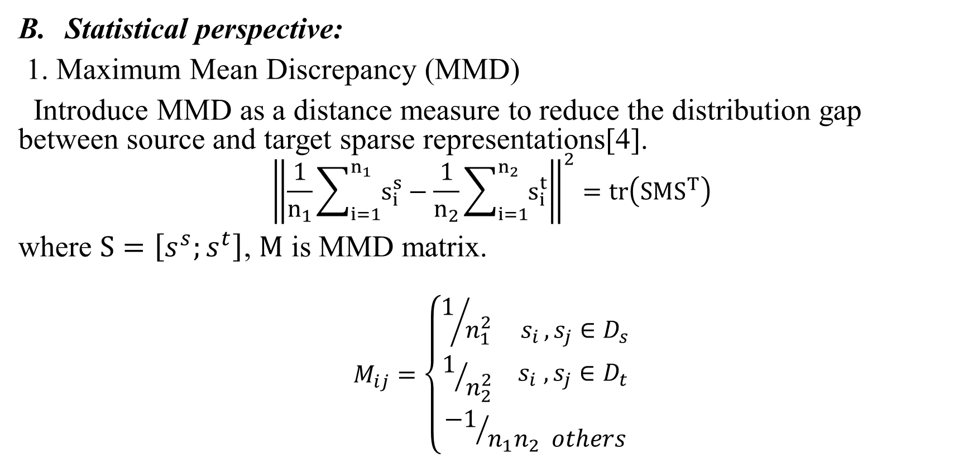
Related works
Statistical perspective:
1. Maximum Mean Discrepancy (MMD)
Introduce MMD as a distance measure to reduce the distribution gap between source and target sparse representations[4].
$${\left\|\frac{1}{n_{1}}\sum_{i=1}^{n_{1}}{s_{i}^{s}}−\frac{1}{n_{2}}\sum_{i=1}^{n_{2}}{s_{i}^{t}}\right\|}^{2}=tr\left(SMS^{T}\right)$$
where $S=\left[s^{s};s^{t}\right]$, $M$ is MMD matrix.
$$M_{ij}=\left\{\begin{aligned}1/{n_{1}^{2} s_{i },s_{j}∈D_{s}} \\ 1/{n_{2}^{2}}{ s}_{i },s_{j}∈D_{t} \\ {−1}/{n_{1}n_{2} others}\end{aligned}\right.$$
[4 ]M. Long, G. Ding, J. Wang, J. Sun, Y. Guo and P. Yu, “Transfer Sparse Coding for Robust Image Representation” . In Proc. CVPR., 2013, pp. 23-28

Slide 8
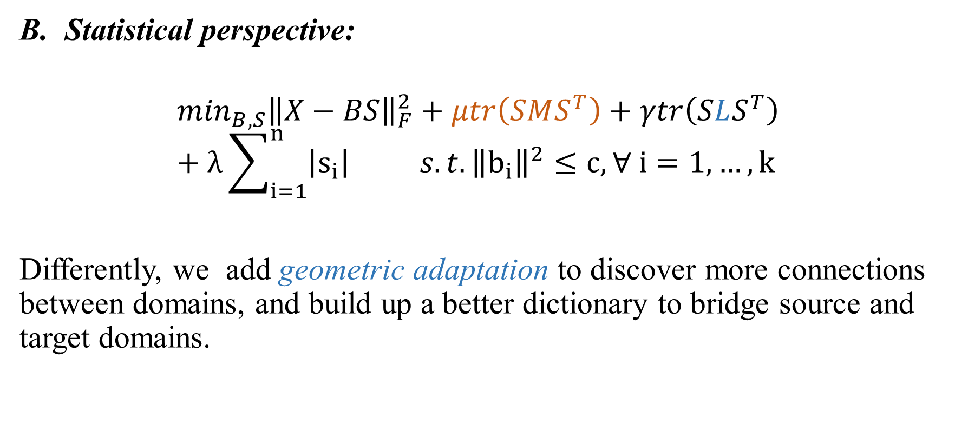
Related works
Statistical perspective:
$$\min_{B,S}{\left\|X−BS\right\|}_{F}^{2}+μtr\left(SMS^{T}\right)+γtr\left(SLS^{T}\right)+λ\sum_{i=1}^{n}{\left|s_{i}\right| s.t. {\left\|b_{i}\right\|}^{2}}≤c, ∀ i=1,…, k$$
Differently, we add geometric adaptation to discover more connections between domains, and build up a better dictionary to bridge source and target domains.

Slide 9
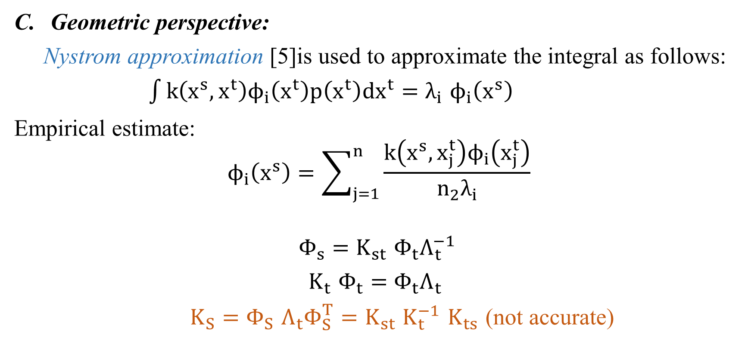
Related works
Geometric perspective:
Nystrom approximation [5]is used to approximate the integral as follows:
$\int{k\left(x^{s},x^{t}\right)ϕ_{i}\left(x^{t}\right)p\left(x^{t}\right)dx^{t}=λ_{i}}$ $ϕ_{i}\left(x^{s}\right)$
Empirical estimate:
$$ϕ_{i}\left(x^{s}\right)=\sum_{j=1}^{n}{\frac{k\left(x^{s}, x_{j}^{t}\right)ϕ_{i}\left(x_{j}^{t}\right)}{n_{2}λ_{i}}}$$
$Φ_{s}=K_{st}$ $Φ_{t}Λ_{t}^{−1}$
$K_{t}$ $Φ_{t}=$ $Φ_{t}Λ_{t}$
$K_{S}=$ $Φ_{S}$ $Λ_{t}Φ_{S}^{T}=$ $K_{st}$ $K_{t}^{−1}$ $K_{ts}$ (not accurate)
[5] C. Williams and M. Seeger, “Using the nystrom method to speed up kernel machines,” in Proc. Adv. NIPS, 2001

Slide 10
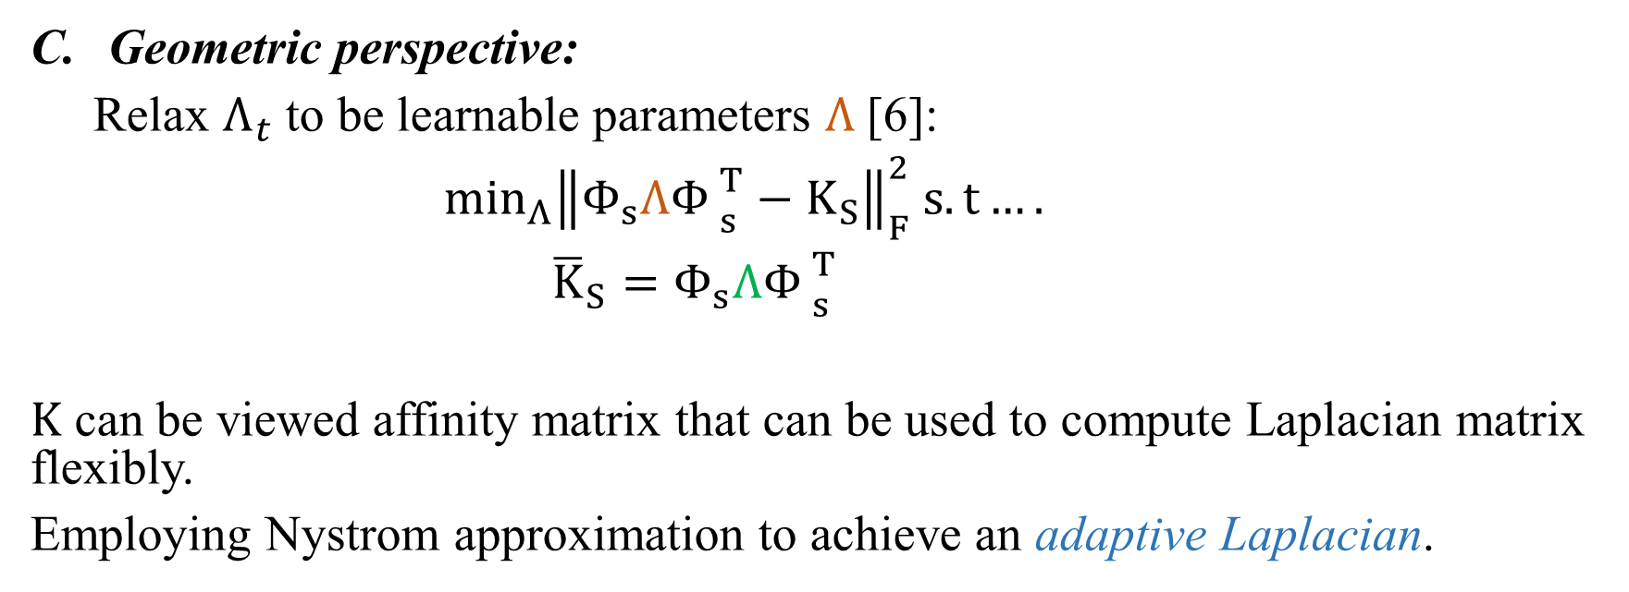
Related works
Geometric perspective:
Relax $Λ_{t}$ to be learnable parameters $Λ_{ }$[6]:
$\min_{Λ}{\left\|Φ_{s}Λ{Φ_{ }}_{s}^{T}−K_{S}\right\|}_{F}^{2} s.t….$
${\overline{K}}_{S}=Φ_{s}Λ{Φ_{ }}_{s}^{T}$
$K$ can be viewed affinity matrix that can be used to compute Laplacian matrix flexibly.
Employing Nystrom approximation to achieve an adaptive Laplacian.
[6] M. Long, J. Wang, J. Sun, P. Yu. “Domain Invariant Transfer Kernel Learning”. IEEE Trans. Knowl. Data Eng., vol. 27, no. 6, pp. 1519-1532, 2014.

Slide 11
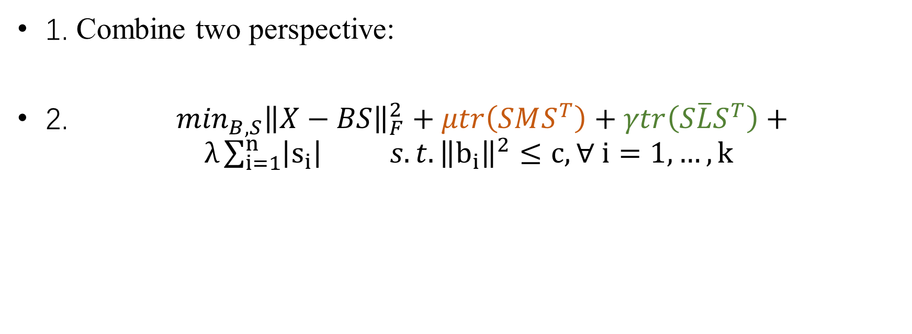
Proposed work
1. Combine two perspective:
2. $\min_{B,S}{\left\|X−BS\right\|}_{F}^{2}+μtr\left(SMS^{T}\right)+γtr\left(S\overline{L}S^{T}\right)+ λ\sum_{i=1}^{n}{\left|s_{i}\right| s.t. {\left\|b_{i}\right\|}^{2}}≤c, ∀ i=1,…, k$

Slide 12
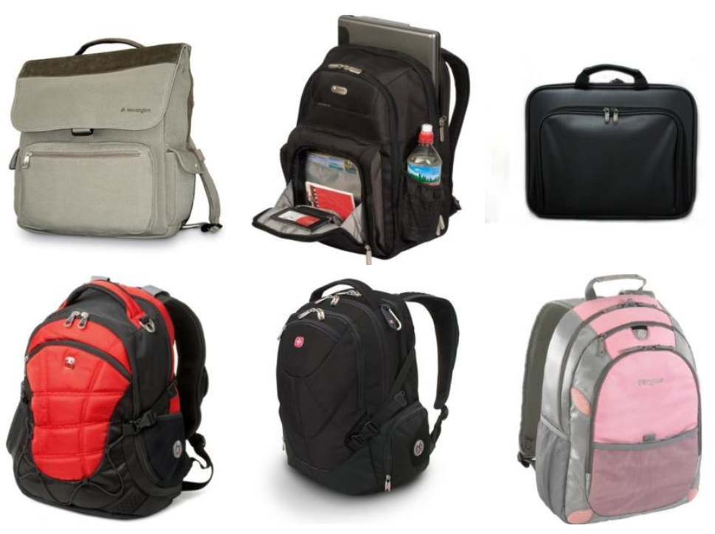
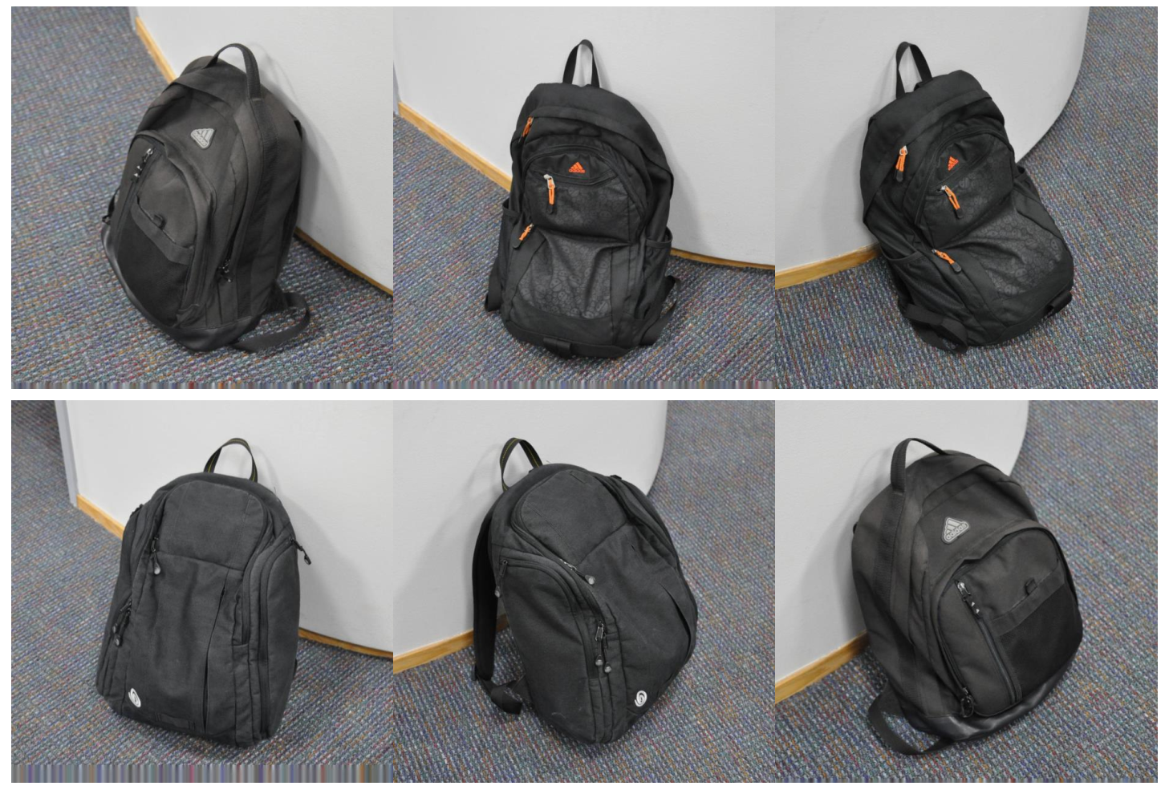
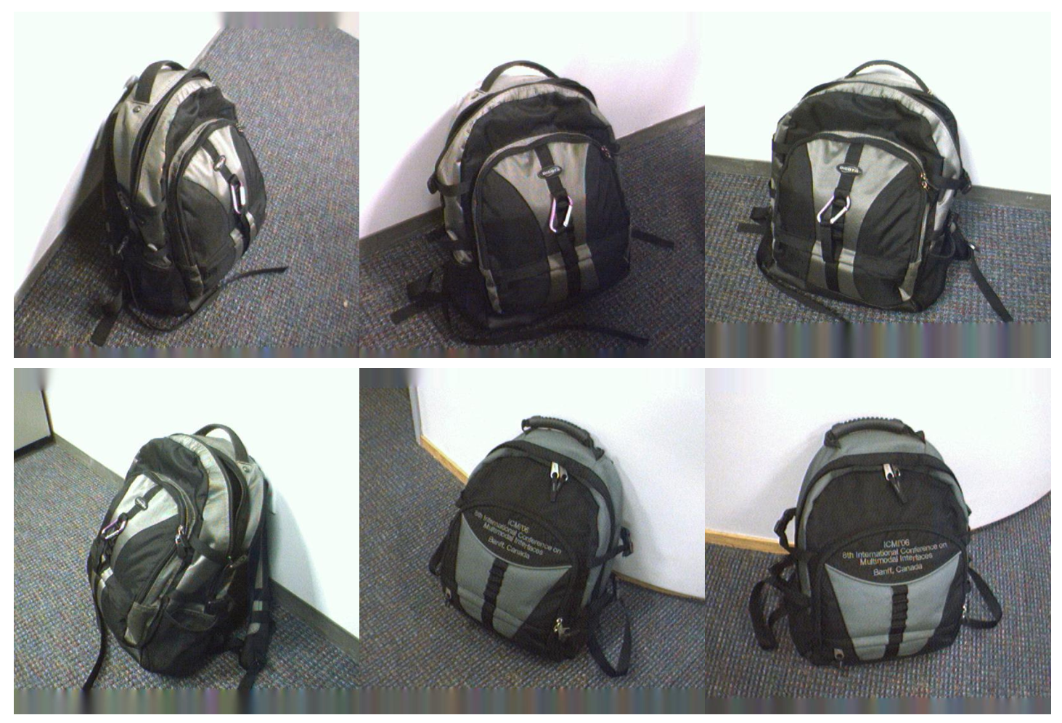
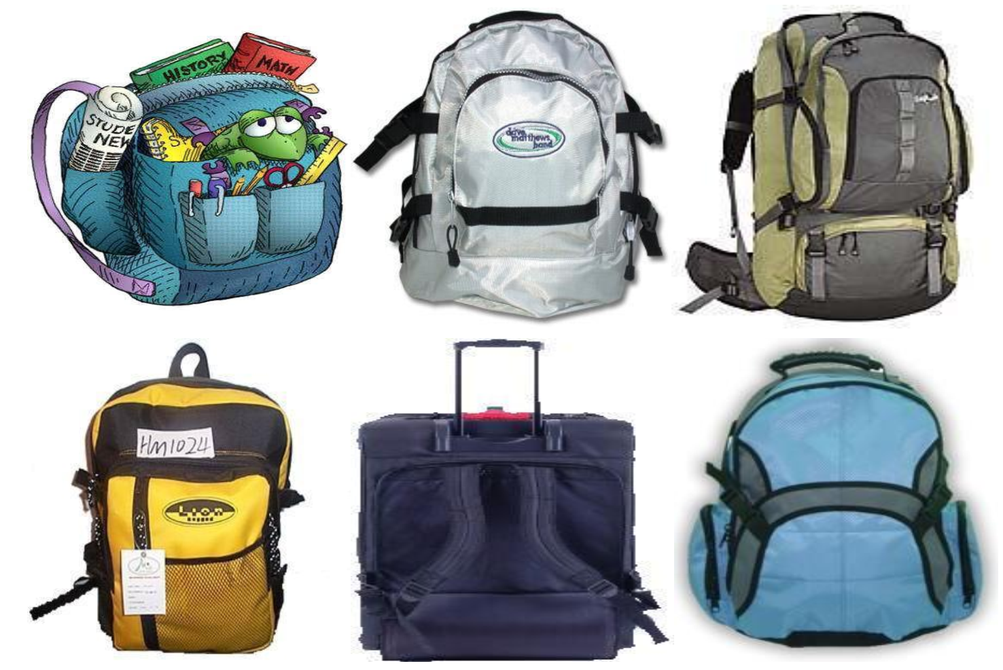
Dataset:
Amazon
Webcam
DSLR
Caltech-256

Slide 13
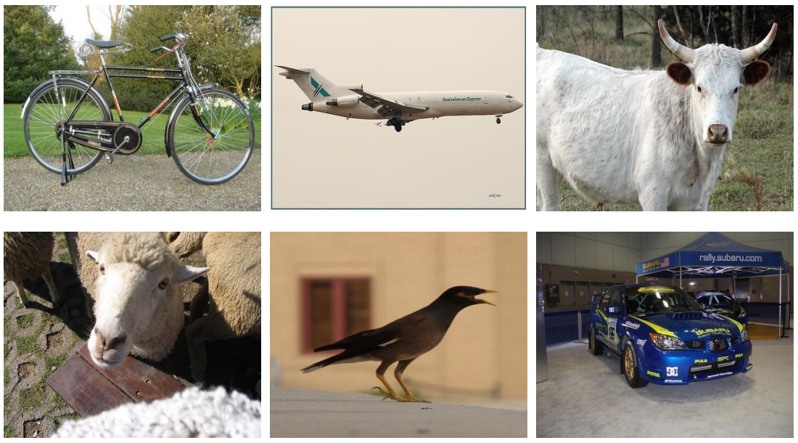
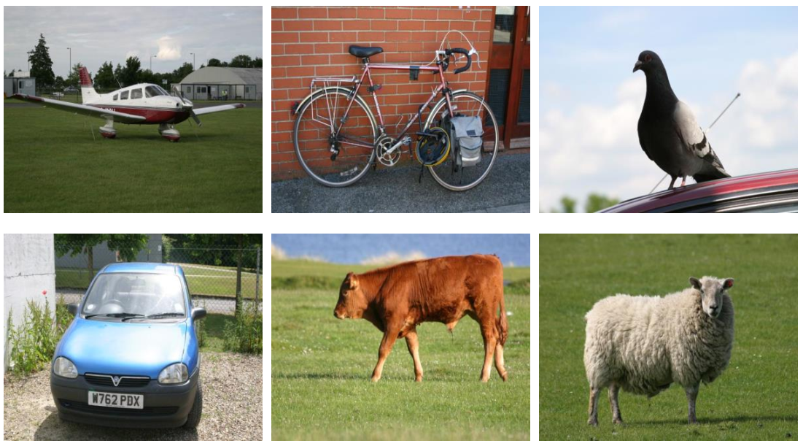
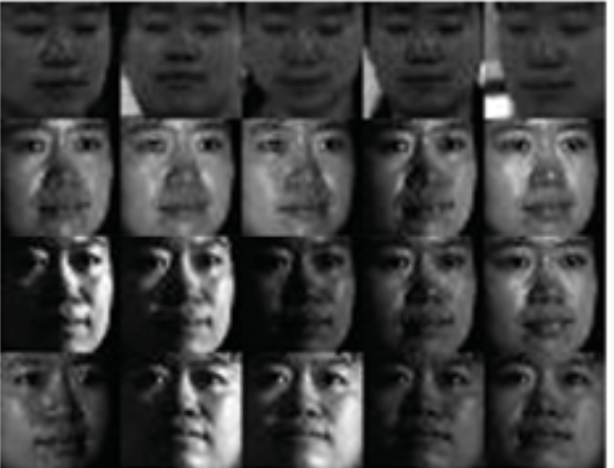
Dataset:
VOC2007
MSRC
PIE

Slide 14
Comparison methods:
Logistic Regression (LR)
Principle Component Analysis (PCA)+LR
Sparse Coding (SC)+LR
Graph Regularized SC (GraphSC)+LR
Transfer Sparse Coding (TSC)+LR
TSC_MMD+LR
Ours
Our_L

Slide 15
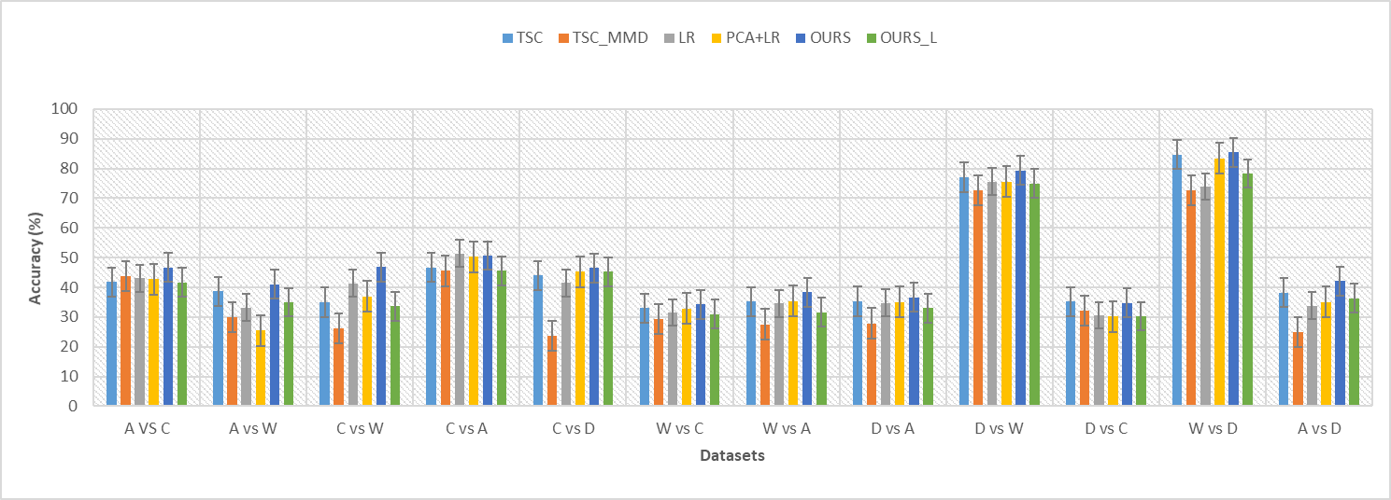
Results

Slide 16
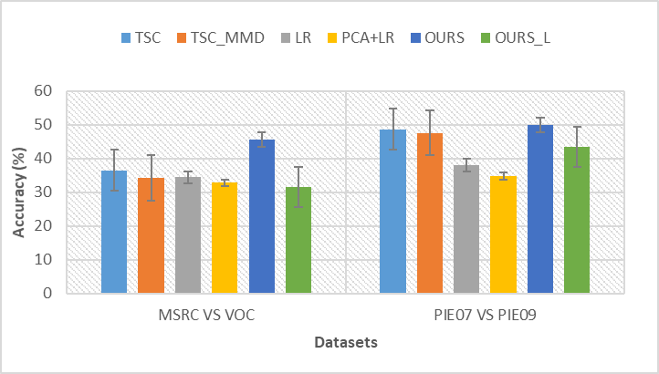
Results

Slide 17
THANK YOU

